Slide 1
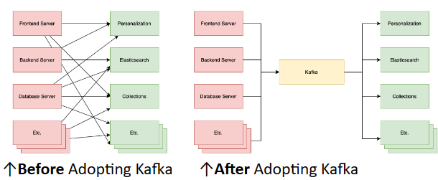
Development Backgrounds 6 Ws (1)
Story of Why
In 2010, LinkedIn found Getting the Big, frequency data from source systems and reliably moving it around was very difficult.
Why difficult?
Different format and storage methods of data
Lost or corrupted during the movement
Without real-time messaging solutions. (before kafka)
What is Kafka
As a publish-subscribe system
With publishers, topics, and subscribers
Partition topics and enable massively parallel consumption (Real time)
Out scope(Difference between conventional approach)
Kafka does not have individual message IDs.
Kafka does not track the consumers that a topic has or who has consumed what messages
E-commerce
Social media
Financial
manufacturing
Kafka's origin story at LinkedIn
Notes:
Kafka's origin story at LinkedIn

Slide 2
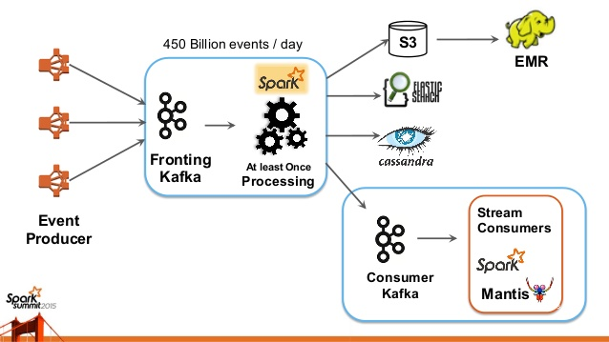
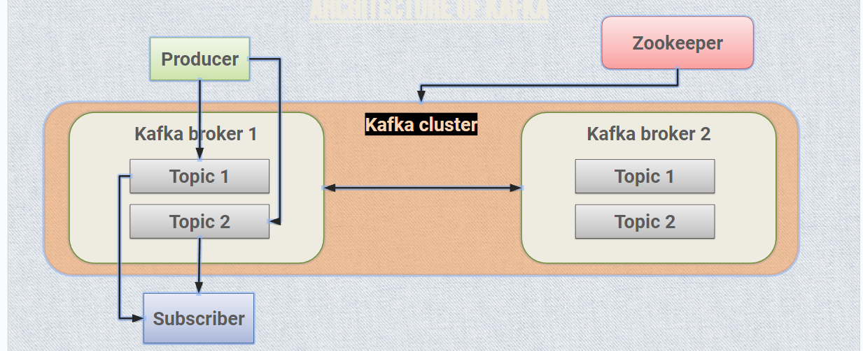

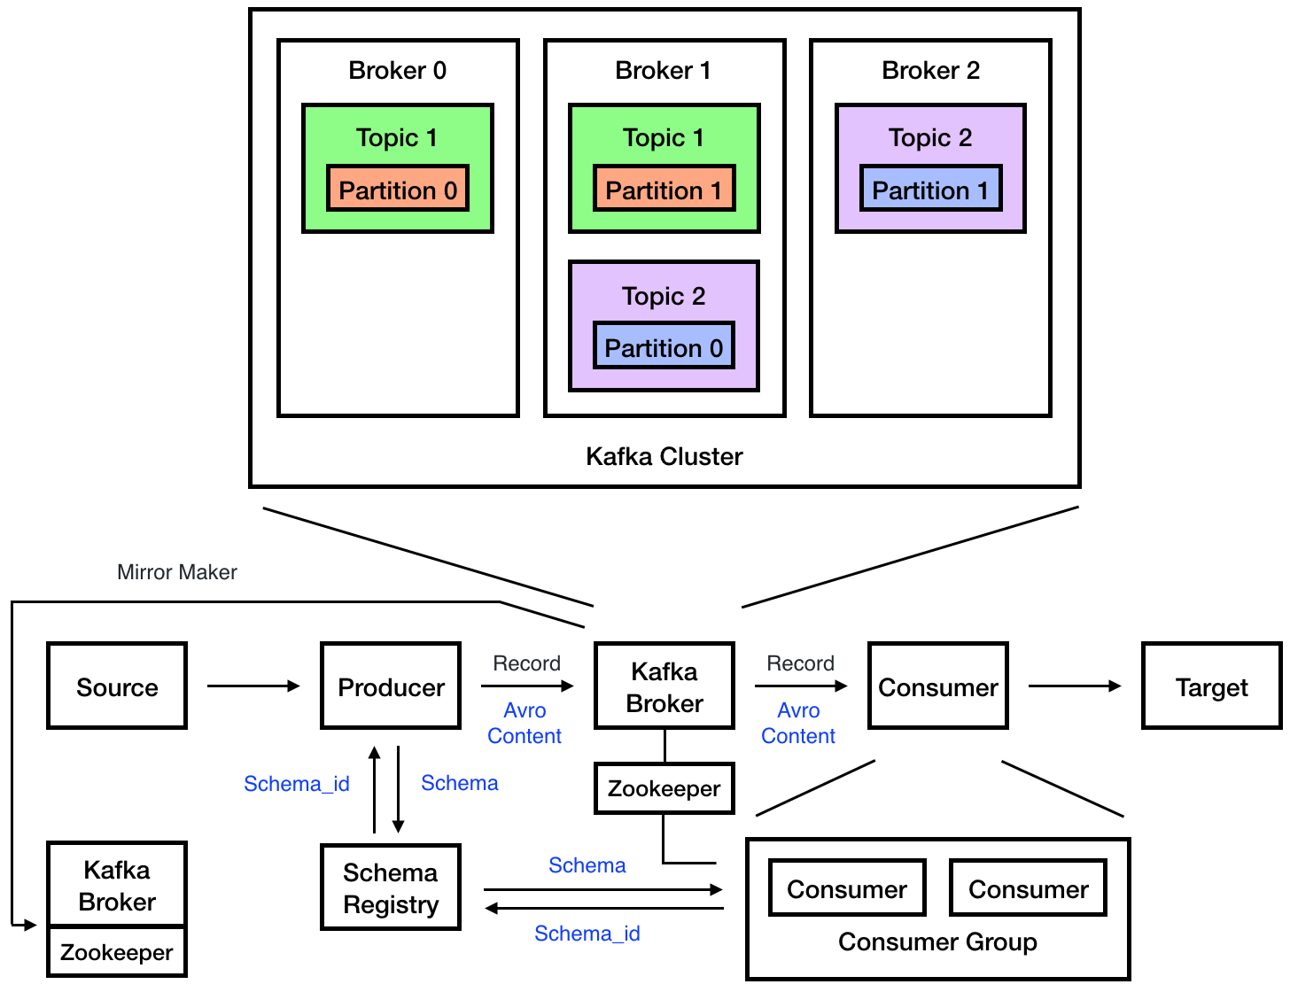

Development Backgrounds 6 Ws (2)
WHO Apache Software Foundation | WHY Real time processing | WHAT Message Broker
WHEN Created (2010) Adopted (2011) | WHERE Linkedin, paypal | HOW Kafka architecture

Slide 3
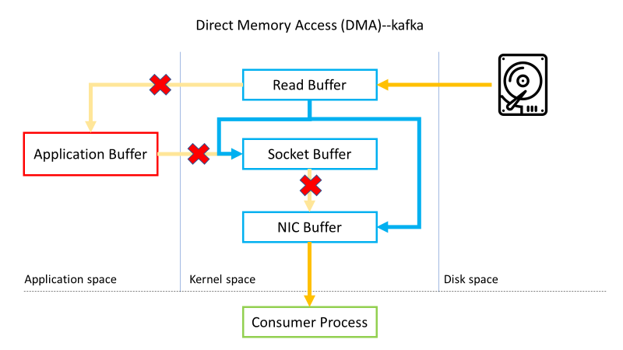
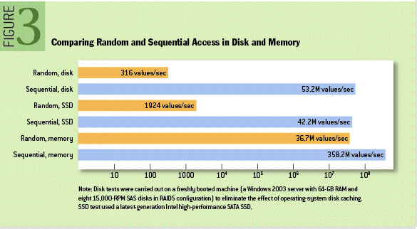
Key Features & Benefits (1)
High Throughput
Capable of handling high-velocity and high-volume data.
Processes millions of messages per second.
Image Source:https://queue.acm.org/detail.cfm?id=1563874
Notes:
傳統的資料檔案拷貝過程如下圖所示，大概可以分成四個步驟：
(1) 作業系統將資料從磁碟中載入到核心空間的Read Buffer（頁面快取區）中。
(2) 應用程式將Read Buffer中的資料複製到應用空間的應用緩衝區中。
(3) 應用程式將應用緩衝區的資料複製到核心的Socket Buffer中。
(4) 作業系統將資料從Socket Buffer中發送到網卡，透過網卡傳送給資料接收方。
Kafka零拷貝過程
所謂的零拷貝是指將數據在核心空間直接從磁碟文件複製到網卡中，而不需要經由使用者態的應用程式介入。這樣既可以提高數據讀取的性能，也能減少核心態和使用者態之間的上下文切換，提高數據傳輸效率。
在正式介紹零拷貝之前，我們先簡單介紹一下直接內存訪問（Direct Memory Access，DMA）技術。DMA 是零拷貝技術的基石。DMA 傳輸將數據從一個地址空間複製到另一個地址空間。當CPU 初始化這個傳輸動作時，傳輸動作本身由 DMA 控制器來執行和完成。因此，通過DMA，硬體可以繞過CPU，直接訪問系統主記憶體。許多硬體都支持DMA，包括網卡、聲卡、磁碟驅動控制器等。
有了DMA 技術的支持，網卡可以直接訪問核心空間的內存，實現了核心空間和應用空間之間的零拷貝，極大地提升了傳輸性能。下圖展示了Kafka 零拷貝的數據傳輸過程。數據傳輸過程簡化為以下步驟：
(1) 操作系統將數據從磁碟中加載到核心空間的Read Buffer（頁面快取區）中。
(2) 操作系統將數據從核心空間的Read Buffer（頁面快取區）傳輸到網卡中，並通過網卡將數據發送給接收方。
(3) 操作系統將數據的描述符複製到Socket Buffer中。Socket緩衝區中僅複製一個描述符，不會將數據複製到Socket緩衝區。
Kafka將日誌記錄持久化到本地磁碟中。通常我們會擔心磁碟的讀寫性能較差，對於Kafka的性能提出質疑。實際上，無論是內存還是磁碟，快慢取決於訪問的方式。磁碟可以分為順序讀寫和隨機讀寫，而內存也可以分為順序讀寫和隨機讀寫。基於磁碟的隨機讀寫確實較慢，但磁碟的順序讀寫性能非常高，一般情況下要比磁碟的隨機讀寫性能高三個數量級，有些情況下甚至比內存的隨機讀寫性能還要高。
磁碟的順序讀寫是磁碟使用模式中最有規律的，並且操作系統也對這種模式進行了大量優化。Kafka利用磁碟的順序讀寫來提升性能。Kafka的消息是不斷追加到本地磁碟文件的末尾，而不是隨機寫入，這使得Kafka的寫入吞吐量顯著提升。
這種方法有一個缺陷，即無法刪除數據，因此Kafka不會刪除數據，它會保留所有的數據。每個消費者對每個主題都有一個偏移量（offset）來表示讀取到了第幾條數據。
如果不刪除硬碟上的數據，則硬碟的空間肯定會被耗盡，因此Kafka提供了兩種策略來刪除數據。一種是基於時間，另一種是基於分區文件的大小。

Slide 4
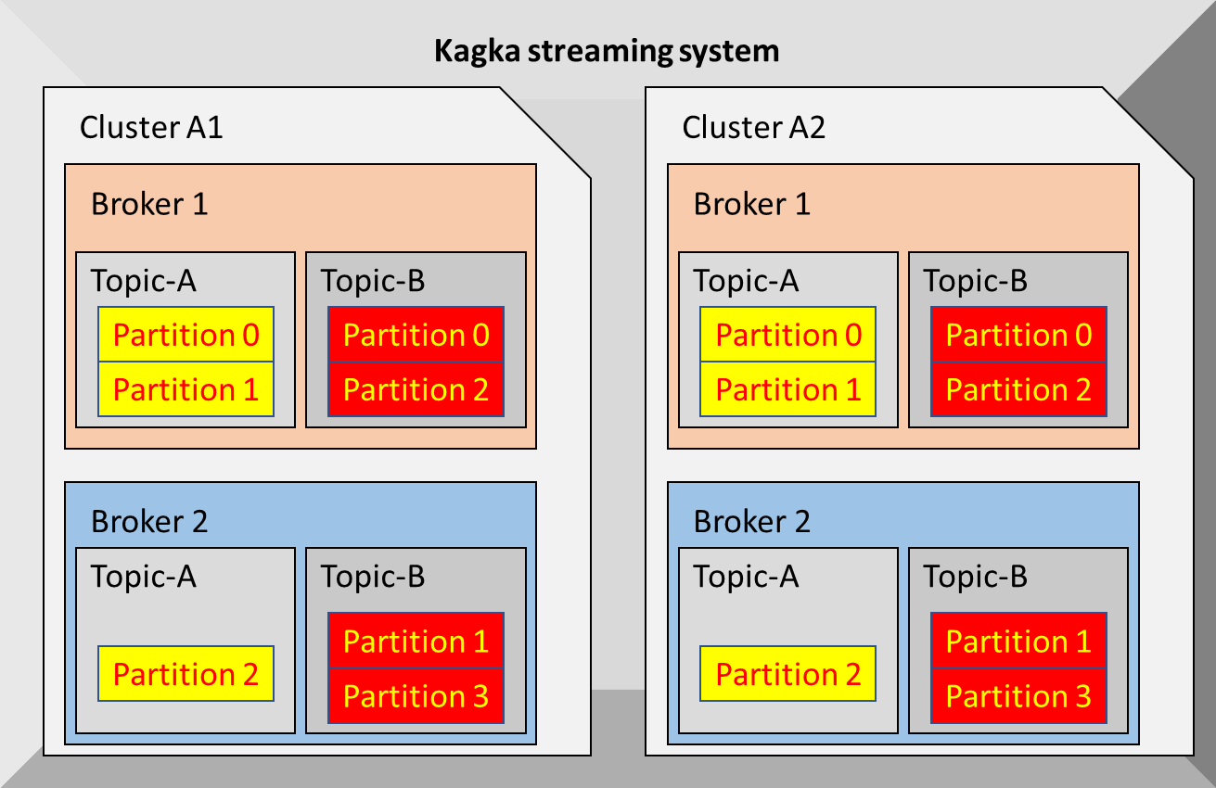
Key Features & Benefits (2)
High Scalability
Scale Kafka clusters up to a thousand brokers.
Handle trillions of messages per day.
Manage petabytes of data.
Support hundreds of thousands of partitions.
Elastically expand and contract storage and processing.

Slide 5
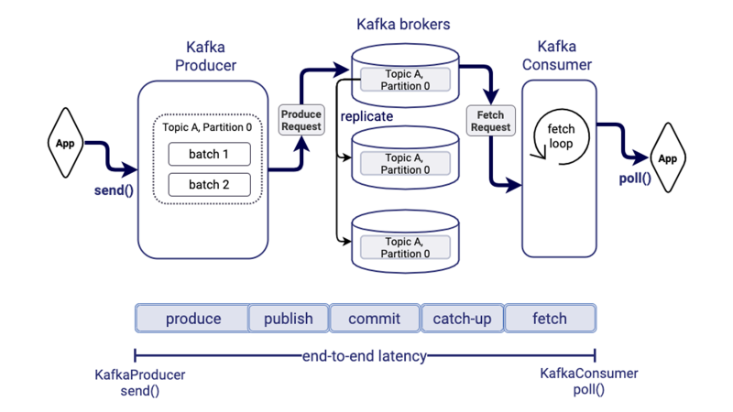
Key Features & Benefits (3)
Low Latency
Deliver high volume of messages.
Utilize a cluster of machines.
Achieve low latencies as low as 2ms.

Slide 6
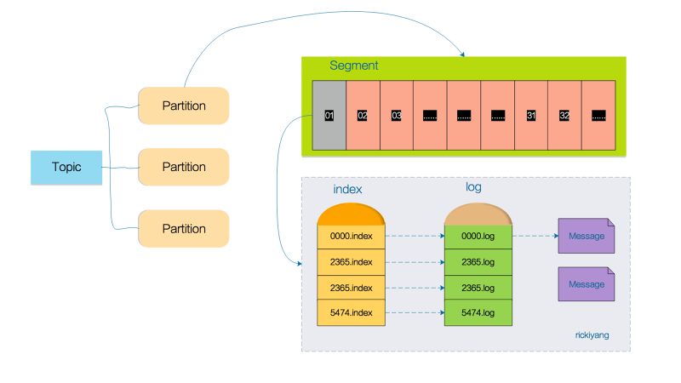
Key Features & Benefits (4)
Permanent Storage
Safely and securely store streams of data.
Use a distributed cluster for storage.
Ensure durability and reliability of data.
Provide fault tolerance in the cluster.

Slide 7
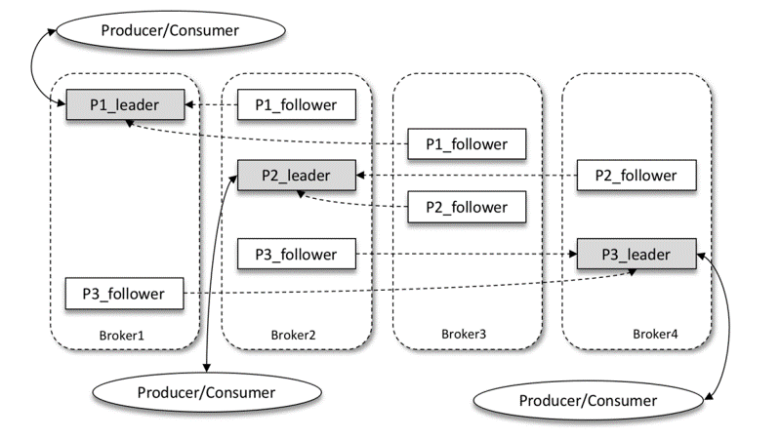
Key Features & Benefits (5)
High Availability
Efficiently extend clusters over availability zones.
Connect clusters across geographic regions.
Ensure high availability and fault tolerance.
Eliminate the risk of data loss.

Slide 8
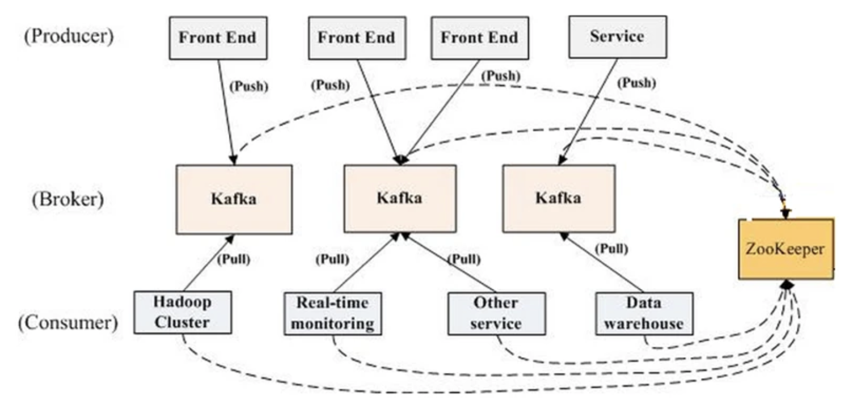
How Does It Work (1)
Notes:
如上图所示，一个典型的 Kafka 集群中包含若干 Producer（可以是 web 前端产生的 Page View，或者是服务器日志，系统 CPU、Memory 等），若干 broker（Kafka 支持水平扩展，一般 broker 数量越多，集群吞吐率越高），若干 Consumer Group，以及一个 Zookeeper 集群。Kafka 通过 Zookeeper 管理集群配置，选举 leader，以及在 Consumer Group 发生变化时进行 rebalance。Producer 使用 push 模式将消息发布到 broker，Consumer 使用 pull 模式从 broker 订阅并消费消息。
https://www.infoq.cn/article/kafka-analysis-part-1/

Slide 9
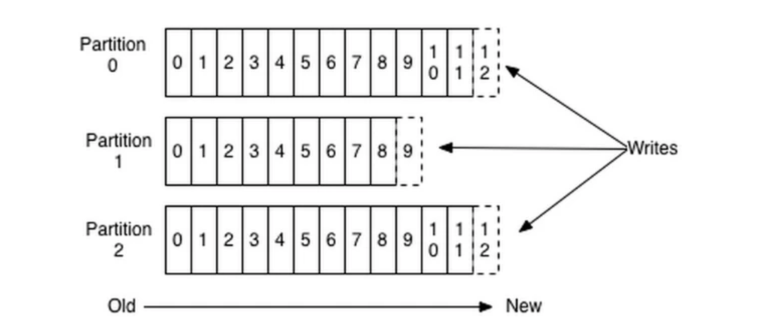
How Does It Work (2)
Because each message is appended to the partition, which is sequential disk writing, the efficiency is extremely high. It has been verified that sequential disk writing is even more efficient than random memory writing, which is a crucial factor in ensuring Kafka's high throughput.
For traditional message queues, it is common practice to delete messages that have been consumed. However, a Kafka cluster retains all messages.
Notes:
因为每条消息都被 append 到该 Partition 中，属于顺序写磁盘，因此效率非常高（经验证，顺序写磁盘效率比随机写内存还要高，这是 Kafka 高吞吐率的一个很重要的保证）。
对于传统的 message queue 而言，一般会删除已经被消费的消息，而 Kafka 集群会保留所有的消息，无论其被消费与否。当然，因为磁盘限制，不可能永久保留所有数据，因此 Kafka 提供两种策略删除旧数据。一是基于时间，二是基于 Partition 文件大小。例如可以通过配置 ，让 Kafka 删除一周前的数据，也可在 Partition 文件超过 1GB 时删除旧数据，

Slide 10
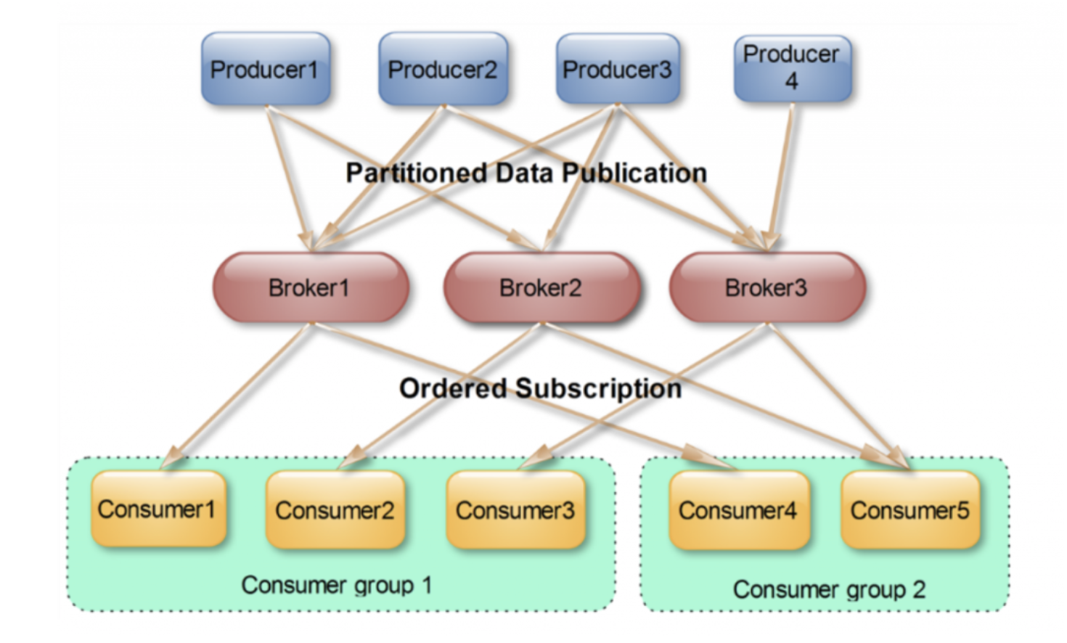
How Does It Work (3)
This is Kafka's means of implementing broadcasting and unicasting of topic messages. A topic can correspond to multiple consumer groups. To achieve broadcasting, each consumer needs to have an independent group. To achieve unicasting, all consumers should be in the same group. By using consumer groups, consumers can be freely grouped without the need to send messages multiple times to different topics.
Notes:
使用 Consumer high level API 时，同一 Topic 的一条消息只能被同一个 Consumer Group 内的一个 Consumer 消费，但多个 Consumer Group 可同时消费这一消息。
这是 Kafka 用来实现一个 Topic 消息的广播（发给所有的 Consumer）和单播（发给某一个 Consumer）的手段。一个 Topic 可以对应多个 Consumer Group。如果需要实现广播，只要每个 Consumer 有一个独立的 Group 就可以了。要实现单播只要所有的 Consumer 在同一个 Group 里。用 Consumer Group 还可以将 Consumer 进行自由的分组而不需要多次发送消息到不同的 Topic。

Slide 11
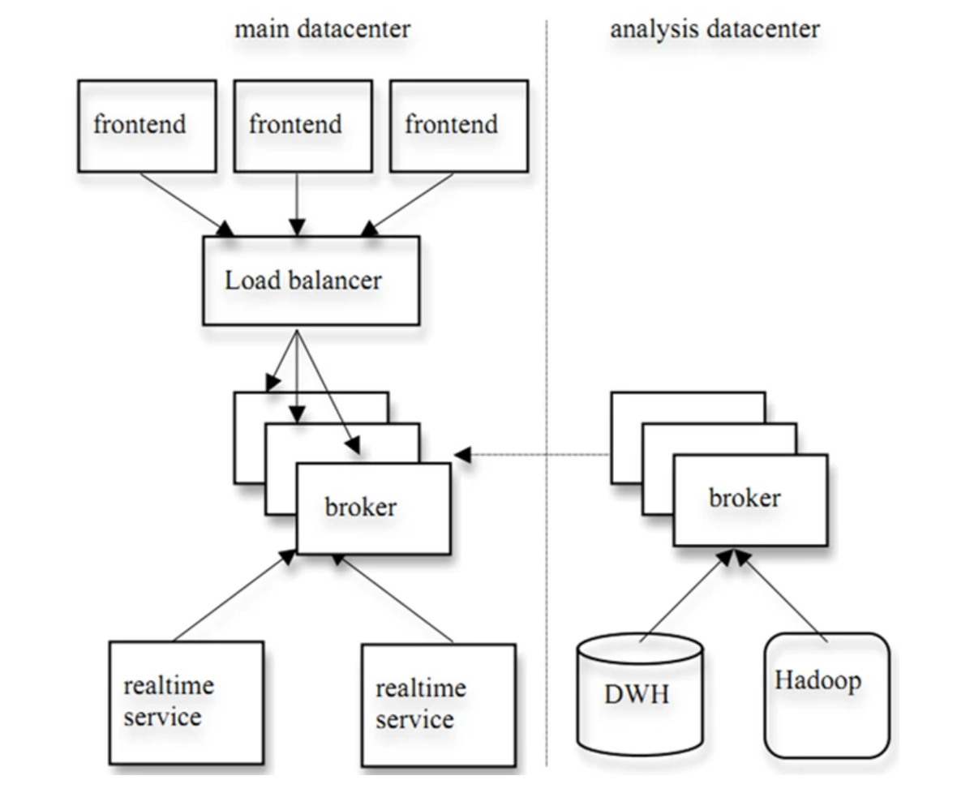
How Does It Work (4)
One of Kafka's design principles is to provide both offline processing and real-time processing simultaneously. Based on this feature, one can use a real-time streaming processing system like Storm for real-time online processing of messages, while using a batch processing system like Hadoop for offline processing. It is also possible to simultaneously replicate data in real-time to another data center.
Notes:
实际上，Kafka 的设计理念之一就是同时提供离线处理和实时处理。根据这一特性，可以使用 Storm 这种实时流处理系统对消息进行实时在线处理，同时使用 Hadoop 这种批处理系统进行离线处理，还可以同时将数据实时备份到另一个数据中心，只需要保证这三个操作所使用的 Consumer 属于不同的 Consumer Group 即可。下图是 Kafka 在 Linkedin 的一种简化部署示意图。

Slide 12
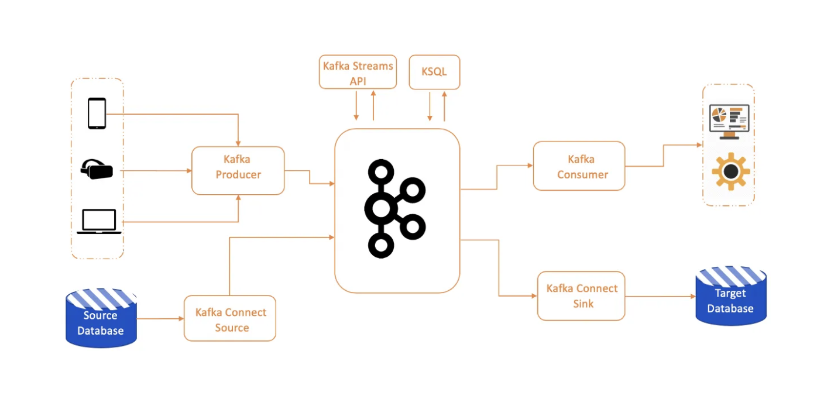
How Does It Work (5)
Kafka EcoSystem
Kafka is a horizontally scalable system that can run on a cluster of nodes across multiple regions, enabling each broker to handle messages in the terabyte range without compromising performance. Once the Kafka cluster is set up, external applications can interact with the cluster using the Kafka API to publish, transform, or consume messages.
Notes:
Kafka EcoSystem
Kafka 具有水平可擴展性，可以在跨多個節點和多個區域部署的代理集群上運行，每個代理能夠處理 TB 級消息而不會影響性能。 一旦 Kafka 集群建立起來，外部應用程序就可以使用 Kafka API 與集群進行交互，推送、轉換或消費消息。

Slide 13
How Does It Work (6)
Kafka API
Under Kafka EcoSystem, it’s important to understand different APIs for consuming data and corresponding use cases. Some of the most popular Kafka use cases in Industry are:
Building scalable and reliable messaging platforms which deliver messages at high throughput.
Decoupling system dependencies.
Build real-time event processing systems with machine learning, AI-based processing.
Build distributed data processing pipeline to handle ETL tasks.
Using as a storage system.

Slide 14

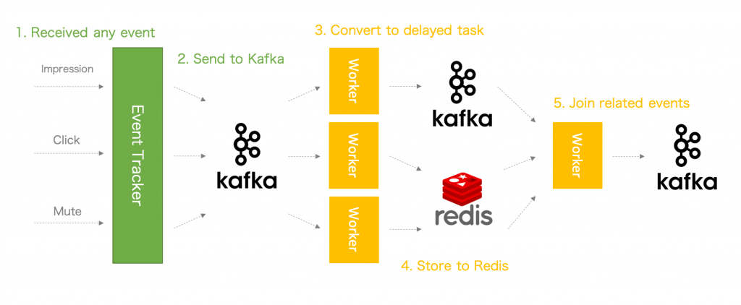
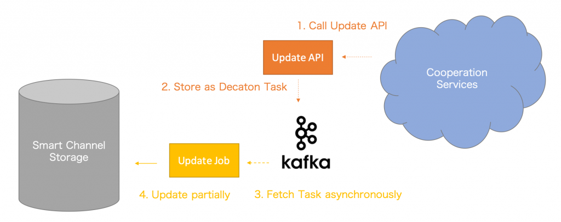

More than 60 services use Kafka
140+ billions messages /day
38+ TB incoming data /day
3.5+ million messages /sec on peak
Multi-services
Big streaming data
Real-time Stat.
Another app server
Application Server
Stat ststem
produce once, unified data format, general info
Kafka
Synchronized info. update across services
Abuser detection system
Application Case Study Line with Kafka

Slide 15
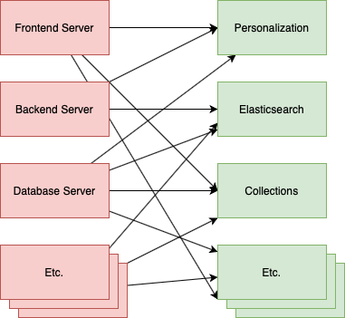
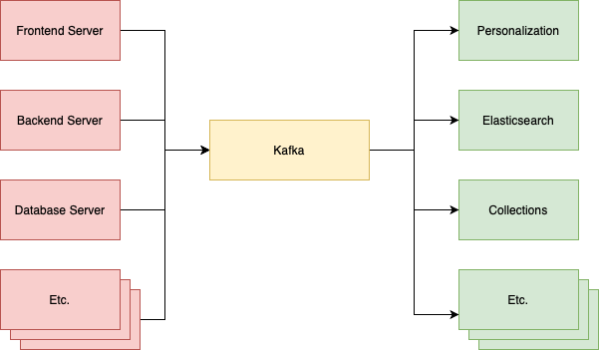
Application Case Study (1)
Apache Kafka was developed by Linkedin in 2010.
To solve data pipeline problem.
Designed for big data streaming processing.
Capable of handling tens of thousands of requests per second
↑Before Adopting Kafka
↑After Adopting Kafka
Notes:
Apache Kafka 最初由 Linkedin 所開發為了解決 data pipeline 問題
不同於其他的訊息處理系統，Apache Kafka 是針對 big data streaming 處理而設計，可以輕易達到每秒上萬等級 requests
採用 Kafka 前 每個應用之間都需要知道彼此的 API 接口才能串接，或是如果一方暫時故障無法回應，可能就會失去資料。
當使用 Kafka 後 可以將低其元件之間的耦合，且讓資料流變的清晰可見。

Slide 16
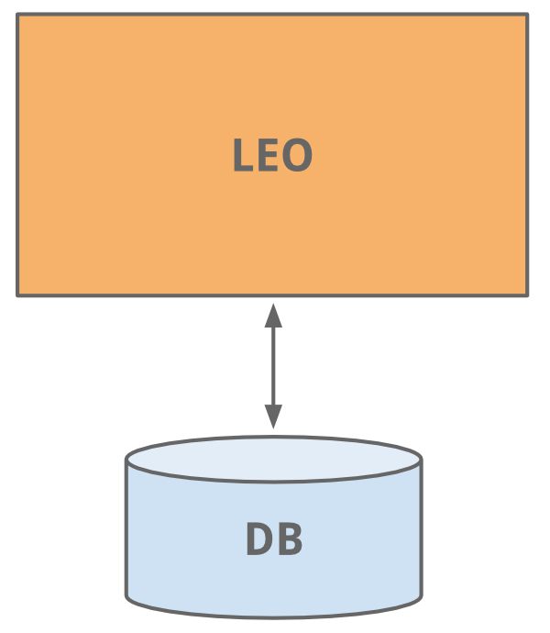
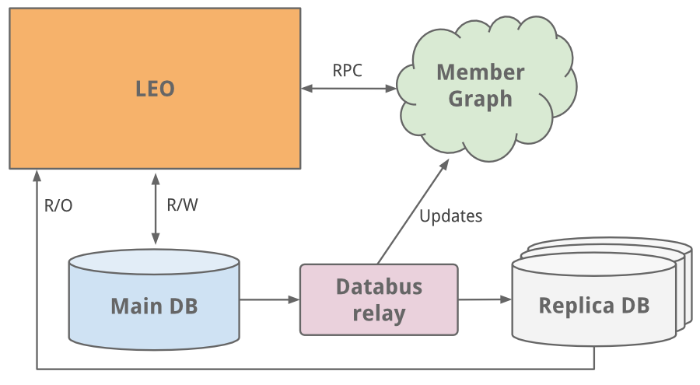
Application Case Study (2) - LinkedIn
The early years-LEO
As a single monolithic application doing it all.
Hosted web servlets for all the various pages, handled business logic, and connected to a handful of LinkedIn databases.
throw more CPUs and memory
Notes:
Leo
LinkedIn 的起步與今天許多網站的起步一樣，作為一個單一的整體應用程序來完成所有事情。 LinkedIn started as many sites start today, as a single monolithic application doing it all.
它為所有不同的頁面託管 web servlet，處理業務邏輯，並連接到少數 LinkedIn 數據庫。 It hosted web servlets for all the various pages, handled business logic, and connected to a handful of LinkedIn databases.
隨著網站的發展，Leo 也在發展，其角色和責任也在增加，自然而然地也增加了它的複雜性。負載平衡有助於啟動多個 Leo 實例。但增加的負載正在加重 LinkedIn 最關鍵的系統——其會員資料數據庫的負擔。 As the site grew, so did Leo, increasing its role and responsibility, and naturally increasing its complexity. Load balancing helped as multiple instances of Leo were spun up. But the added load was taxing LinkedIn’s most critical system - its member profile database.
我們做的一個簡單的修復是經典的垂直縮放——投入更多的 CPU 和內存！ An easy fix we did was classic vertical scaling - throw more CPUs and memory at it!

Slide 17

Application Case Study (3) - LinkedIn
However, as the site began to see more and more traffic
Leo was often going down in production,
Difficult to troubleshoot and recover,
Difficult to release new code
High Availability is critical to LinkedIn.
Notes:
Leo
隨著網站流量越來越大，我們的單體應用 Leo 經常在生產環境中宕機，很難進行故障排除和恢復，也很難發布新代碼。高可用性對 LinkedIn 至關重要。很明顯，我們需要“殺死 Leo”並將其分解為許多小型功能。 As the site began to see more and more traffic, our single monolithic app Leo was often going down in production, it was difficult to troubleshoot and recover, and difficult to release new code. High availability is critical to LinkedIn. It was clear we needed to “Kill Leo” and break it up into many small functional.

Slide 18
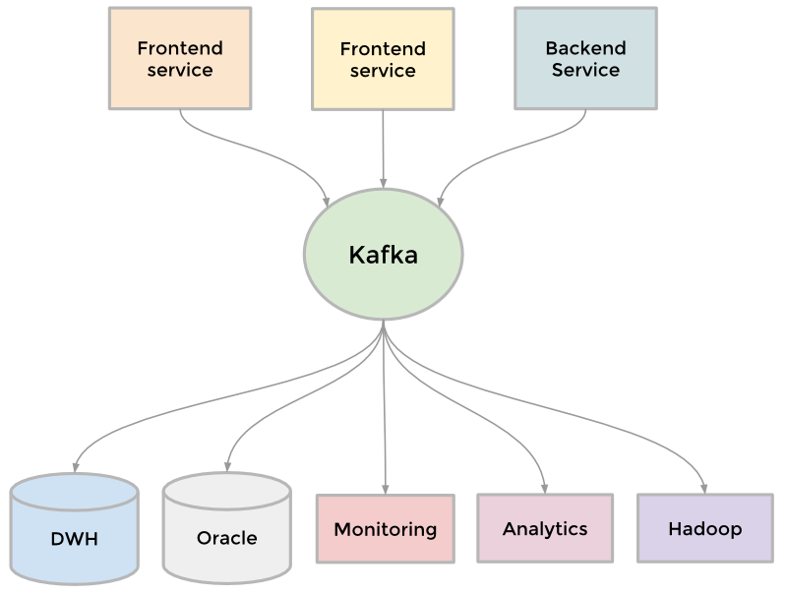
Application Case Study (4) - LinkedIn
Demand:
Sending batches of data into our Hadoop workflow for analytics
Collecting and aggregating logs from every service
Collecting tracking events like pageviews
Keeping search system up to date whenever profile is updated.
To collect the growing amount of data → Result: the development of Kafka
Notes:
Kafka
為了收集越來越多的數據 To collect its growing amount of data
Example
需要將成批數據發送到我們的Hadoop 工作流中進行分析 we needed to send batches of data into our Hadoop workflow for analytics
收集並聚合來自每個服務的日誌 we collected and aggregated logs from every service
收集頁面瀏覽量等跟踪事件 we collected tracking events like pageviews
當有人更新個人資料時，讓搜索系統保持最新。 we needed to keep our people search system up to date whenever someone updated their profile.
結果是開發了我們的分佈式發布-訂閱消息傳遞平台Kafka 。 The result was the development of Kafka, our distributed pub-sub messaging platform.

Slide 19
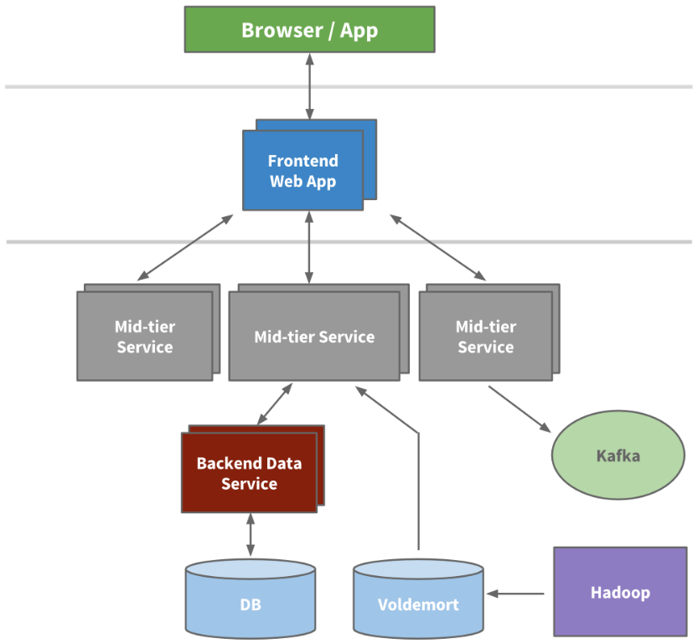
Application Case Study (5) - LinkedIn
Characteristic of Kafka:
Built around the concept of a commit log with speed and scalability.
Enabled near real-time access to any data source.
Empowered our Hadoop jobs.
Allowed to build real-time analytics.
Improved site monitoring and alerting capability.
→ Kafka handles well over 500 billion events per day.
Notes:
Kafka 成為一個通用管道
圍繞提交日誌的概念構建，並且在構建時考慮了速度和可擴展性 Kafka became a universal pipeline, built around the concept of a commit log, and was built with speed and scalability in mind.
它支持近乎實時地訪問任何數據源 It enabled near real-time access to any data source.
支持 Hadoop 作業 empowered our Hadoop jobs
允許構建實時分析 allowed us to build real-time analytics
極大地改進我們的站點監控和警報能力 vastly improved our site monitoring and alerting capability
→如今，Kafka每天處理超過5000 億個事件。（Today, Kafka handles well over 500 billion events per day.）

Slide 20

Application Case Study (6) - LinkedIn
Utilization of Kafka at LinkedIn
Monitoring All hosts at LinkedIn emit metrics through Kafka. Then collected and processed to create monitoring dashboards and alerts.
Messaging Various applications leverage Kafka as a traditional messaging system Application Including: Search, Content Feed and Relevance.
Analytics Information are sent into a Kafka cluster in each data center. Events are collected and pushed onto Hadoop for analysis and daily report.
As a building block (log) in various distributed applications/platforms Kafka is also leveraged as a core building block by other products like Pinot.
Notes:
The LinkedIn engineering team has developed and built Apache Kafka into a powerful open source solution for managing streams of information. LinkedIn 工程團隊已經開發並將Apache Kafka構建為一個強大的開源解決方案，用於管理信息流。
Today, some of the common scenarios at LinkedIn that leverage Kafka include:
如今，LinkedIn 使用 Kafka 的一些常見場景包括：
Monitoring監控
All hosts at LinkedIn emit metrics pertaining to their system and application health through Kafka. These are then collected and processed to create monitoring dashboards and alerts. LinkedIn 的所有主機都通過 Kafka 發出與其係統和應用程序健康相關的指標。然後收集和處理這些信息以創建監控儀表板和警報。
Messaging消息傳遞
Various applications at LinkedIn leverage Kafka as a traditional messaging system for standard queuing and pub-sub messaging. LinkedIn 的各種應用程序利用 Kafka 作為標準隊列和發布-訂閱消息傳遞的傳統消息傳遞系統。 These applications range from Search, Content Feed and Relevance and they publish processed data into online data serving stores like Voldemort, etc. 這些應用程序包括搜索、內容提要和相關性，它們將處理後的數據發佈到 Voldemort 等在線數據服務商店。
Analytics分析
LinkedIn tracks data to better understand how our members use our products. Information such as which page got viewed and which content got clicked on are sent into a Kafka cluster in each data center. These events are all centrally collected and pushed onto our Hadoop grid for analysis and daily report generation.
LinkedIn 跟踪數據以更好地了解我們的會員如何使用我們的產品。諸如查看了哪個頁面和點擊了哪些內容等信息被發送到每個數據中心的 Kafka 集群中。這些事件全部集中收集並推送到我們的 Hadoop 網格上以進行分析和每日報告生成。
As a building block (log) in various distributed applications/platforms 作為各種分佈式應用程序/平台中的構建塊（日誌）
Kafka is also leveraged as a core building block (distributed log) by other products like our big data warehousing solution Pinot. We are also working on using Kafka as an internal replication and change propagation layer for our distributed database Espresso.
Kafka 還被其他產品（如我們的大數據倉庫解決方案Pinot）用作核心構建塊（分佈式日誌）。我們還致力於將 Kafka 用作分佈式數據庫 Espresso 的內部複製和更改傳播層。
https://www.infoq.cn/article/2015/02/kafka-linkedin-application

Slide 21
Study Comments (20%)
Your abstract/evaluation?
Kafka is an efficient handling of real-time data streams with scalable, fault-tolerant, and high-throughput messaging system
Any impact to you from your study and understanding?
It has provided me how social applications like Line, Facebook is worked.
Any comparison and alternative better technology?
Apache Pulsar, RabbitMQ, and Apache ActiveMQ.
Any questions? How (methodology) to find the answers by yourself?
We develop the methodology from application which used Kafka . e.g. Line
Notes:
認知’ kafka的意義’ 心得

Slide 22
Reference(s) (5%)
Title: Apache Kafka 介紹 Author: Chi-Hsuan Huang https://medium.com/@chihsuan/introduction-to-apache-kafka-1cae693aa85e Published Date: Apr 12, 2020
Title: A Brief History of Scaling LinkedIn Author: Josh Clemm https://engineering.linkedin.com/architecture/brief-history-scaling-linkedin Published Date: July 20, 2015
Title: Kafka at LinkedIn: Current and Future Author: Mammad Zadeh https://engineering.linkedin.com/kafka/kafka-linkedin-current-and-future Published Date: January 29, 2015
Title: Kafka's origin story at LinkedIn Author: Tanvir Ahmed https://www.linkedin.com/pulse/kafkas-origin-story-linkedin-tanvir-ahmed Published Date: Sep 20, 2019
Title: 細說 Kafka Partition 分區 Author: iriniland 細說 Kafka Partition 分區 - 閱坊 (readfog.com) Published Date: May 7, 2021
Title: 【 Broker 】Apache Kafka 簡介 Author:Archer 【 Broker 】Apache Kafka 簡介 (learningsky.io) Published Date: Aug 29, 2019

Slide 23
Reference(s) (5%)
Title: kafka副本机制 Author: Edgar https://edgar615.github.io/kafka-replicas.html Published Date: Feb 05, 2020
Title: 直观理解：Kafka零拷贝技术（Zero-Copy） Author: 老羊_肖恩 https://www.jianshu.com/p/0af1b4f1e164 Published Date: Nov 30, 2021
Title: Kafka消息存储机制 Author: 星河之码 https://www.modb.pro/db/126424 Published Date: Oct 04, 2021
Title:Low Latency Data Streaming with Apache Kafka and Cloud-Native 5G Infrastructure Author: Kai Waehner https://www.kai-waehner.de/blog/2021/05/23/apache-kafka-cloud-native-telco-infrastructure-low-latency-data-streaming-5g-aws-wavelength/ Published Date: May 23, 2021
Title:Using Apache Kafka as a Scalable, Event-Driven Backbone for Service Architectures Author: Ben Stopford https://www.confluent.io/blog/apache-kafka-for-service-architectures/ Published Date: Jul 19, 2017
Title:Kafka高可用，高吞吐量低延迟的高并发的特性背后实现机制 Author: 明智谈生活 https://www.163.com/dy/article/HL40DHP20552ZN8B.html Published Date: Nov 17, 2022
Title:『卡夫卡的藏書閣』- 程序猿必須懂的Kafka開發與實作系列 Author: daniel_ho https://ithelp.ithome.com.tw/articles/10264758 Published Date: Sep 15, 2021

Slide 24
Reference(s) (5%)
Title: Kafka-based job queue library 'Decaton' examples Author: Kazuki Matsushita Kafka-based job queue library 'Decaton' examples (linecorp.com) Published Date: Dec 10, 2020

Slide 25
TBD
reference >> 不算
how does it work >> 等排版
key feature >> v
減少頁數(不能超過20)
case study 業界青睞 產品發布簡報 客戶應用報告 業務簡報
Study Comments (20%)

